Slide 1

Walmart Sales Analysis
SQl queries and business insights

Slide 2
INTRODUCTION
• Walmart operates across multiple cities, selling a variety of products.
• The dataset includes transaction data. customer demographics, sales figures, and payment methods.
• This project uses MySQL to analyze sales performance, customer behavior, and trends.

Slide 3
BUSINESS PROBLEM
• Walmart aims to optimize its sales strategies.
• The analysis focuses on identifying sales trends, customer segmentation, and product profitability.

Slide 4
DATASET DESCRIPTION
• Dataset includes:
• Branch-wise sales data
• Customer purchase behavior
• Payment methods and product lines
• Sales volume and transaction trends
• Source:
• Walmart Sales Dataset

Slide 5

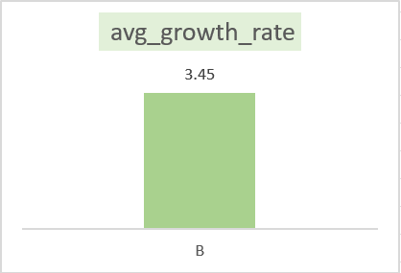
Task 1: Identifying the Top Branch by Sales Growth Rate (6 Marks) Walmart wants to identify which branch has exhibited the highest sales growth over time. Analyze the total sales for each branch and compare the growth rate across months to find the top performer.
with growth as(select branch,date_format(date,'%Y-%m') as month,sum(total) as current_sale,lag(sum(total))over(partition by branch order by date_format(date,'%Y-%m')) as last_sale from walmart group by branch,month)select branch,round(avg(((last_sale - current_sale)/(last_sale))*100),2) as avg_growth_rate from growth group by branch order by avg_growth_rate desc limit 1;

Slide 6
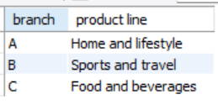
Task 2: Finding the Most Profitable Product Line for Each Branch (6 Marks) Walmart needs to determine which product line contributes the highest profit to each branch. The profit margin should be calculated based on the difference between the gross income and cost of goods sold.
with p_line as(select branch,`product line`,sum(`gross income`) as income,rank() over (partition by branch order by sum(`gross income`) desc) as rank_orderfrom walmart group by branch,`product line`)select branch,`product line` from p_line where rank_order=1;

Slide 7
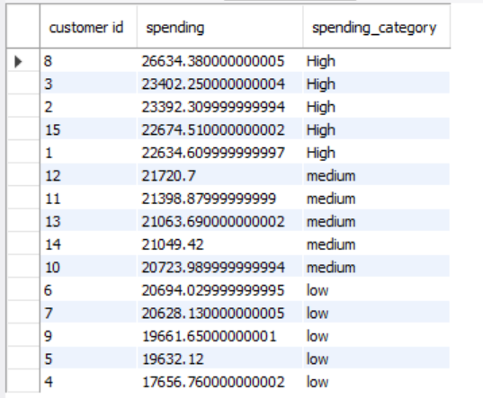
Task 3: Analyzing Customer Segmentation Based on Spending (6 Marks) Walmart wants to segment customers based on their average spending behavior. Classify customers into three tiers: High, Medium, and Low spenders based on their total purchase amounts.
with customertype as(select `customer id`,sum(total) as spending,ntile(3) over(order by sum(total)desc) as spending_typefrom walmart group by `customer id`)select `customer id`,spending,case when spending_type=1 then 'High'when spending_type=2 then 'medium'else 'low'end as spending_categoryfrom customertype;

Slide 8
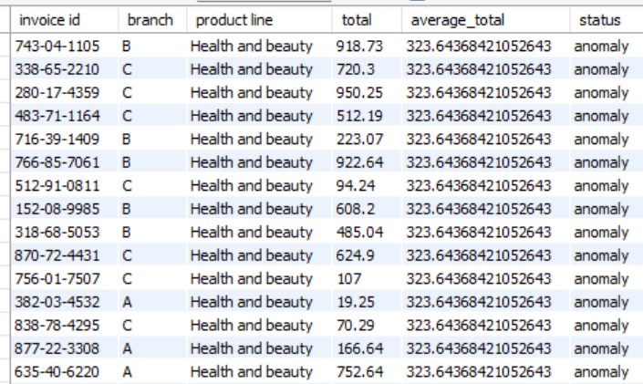
Task 4: Detecting Anomalies in Sales Transactions (6 Marks) Walmart suspects that some transactions have unusually high or low sales compared to the average for the product line. Identify these anomalies.
with productline_avg as (select `product line`,avg(total) as average_total from walmart group by `product line`)select w.`invoice id`,w.branch,w.`product line`,w.total,p.average_total, case when p.average_total*1.3 < w.total then 'anomaly'when p.average_total*0.7 > w.total then 'anomaly'else 'normal'end as statusfrom walmart as w join productline_avg as p on p.`product line`=w.`product line`where p.average_total*1.3 < w.total or p.average_total*0.7 > w.total ;

Slide 9
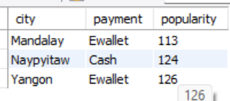
Task 5: Most Popular Payment Method by City (6 Marks) Walmart needs to determine the most popular payment method in each city to tailor marketing strategies.
with popular as (select city,payment,count(*) as popularity,rank() over (partition by city order by count(*) desc) as rnk from walmart group by city,payment order by city,payment )select city,payment,popularity from popular where rnk=1;

Slide 10
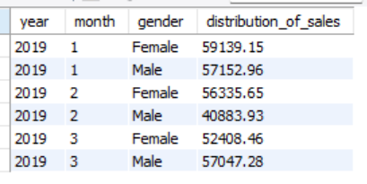
Task 6: Monthly Sales Distribution by Gender (6 Marks) Walmart wants to understand the sales distribution between male and female customers on a monthly basis.
select year(date) as year,month(date) as month,gender,round(sum(total),2) as distribution_of_sales from walmart group by year(date),month(date),gender order by year(date),month(date);

Slide 11
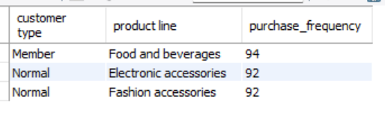
Task 7: Best Product Line by Customer Type (6 Marks) Walmart wants to know which product lines are preferred by different customer types(Member vs. Normal).
select `customer type`,`product line`,purchase_frequency from (select `customer type`,`product line`,count(*) as purchase_frequency,rank() over (partition by `customer type` order by count(*) desc) as rnk from walmart group by `customer type`,`product line`)as ranked_data where rnk=1;

Slide 12
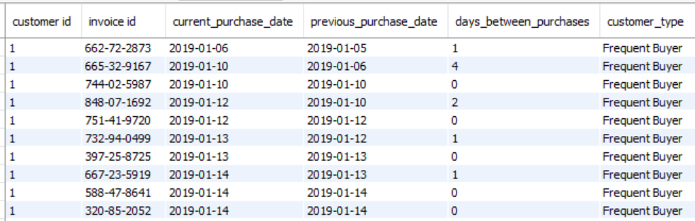
Task 8: Identifying Repeat Customers (6 Marks) Walmart needs to identify customers who made repeat purchases within a specific time frame (e.g., within 30 days).
SELECT * FROM (SELECT `customer id`, `invoice id`, date AS current_purchase_date, LAG(date) OVER (PARTITION BY `customer id` ORDER BY date) AS previous_purchase_date, DATEDIFF(date, LAG(date) OVER (PARTITION BY `customer id` ORDER BY date)) AS days_between_purchases, CASE WHEN LAG(date) OVER (PARTITION BY `customer id` ORDER BY date) IS NULL THEN 'First-time Customer' WHEN DATEDIFF(date, LAG(date) OVER (PARTITION BY `customer id` ORDER BY date)) <= 30 THEN 'Frequent Buyer’ ELSE 'Occasional Buyer' END AS customer_type FROM walmart ) subqueryWHERE customer_type != 'First-time Customer';

Slide 13
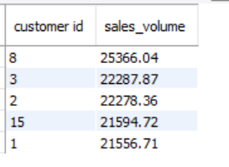
Task 9: Finding Top 5 Customers by Sales Volume (6 Marks) Walmart wants to reward its top 5 customers who have generated the most sales Revenue.
select `customer id`,round(sum(cogs),2) as sales_volume from walmart group by `customer id` order by sum(cogs) desc limit 5;

Slide 14
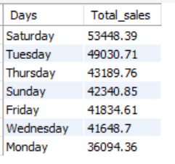
Task 10: Analyzing Sales Trends by Day of the Week (6 Marks) Walmart wants to analyze the sales patterns to determine which day of the week brings the highest sales
select dayname(date) as Days,round(sum(cogs),2) as Total_sales from walmart
group by days
order by Total_sales desc;

Slide 15
CONCLUSION
In conclusion, Walmart's sales data reveals key insights into branch performance,
customer behavior, and sales trends. Branch A's growth suggests strategies to replicate
across other branches, while negative profits highlight the need for cost control and
targeted promotions. High-value customers offer opportunities for loyalty programs,
and regional payment preferences suggest potential for tailored marketing. Addressing
sales anomalies and optimizing inventory can further enhance profitability and
customer satisfaction.

Slide 16
Links
Video Link:
https://www.loom.com/share/27c9a63759e042a9b56afa0f021e5c6f?sid=ce055c9e-816e-4c7b-beec-6e2960c4bcb9
Sql Script Link:
https://drive.google.com/file/d/1uYzkemNdPEgQM8HdCZDyC9i4LzX5g2Ea/view?usp=sharing

